Slide 1

WELCOME TO ENGLISH CLASS

Slide 2


WELCOME TO ENGLISH CLASS
“Always deliver more than expected.”
Larry Page, co-founder of Google

Slide 3




Analyze and Evaluate before deciding

Slide 4

DATE
DATE
Objective:
Students will be able to distinguish between the concepts of Analyzing and Evaluating.

Slide 5
AGENDA
WARM UP:
Describe the picture
CLASS ACTIVITY:
New Vocabulary Video about “Analyze and evaluate before deciding”
Reading Strategy: Making predictions
Reading :Difference between Analyzing and Evaluating
Wrap- Up
Answer these True/False questions about the text.

Slide 6

WARM-UP
Look at the picture and answer the following questions
What is in the picture?
What colors do you see?
What do you like most about the landscape?

Slide 7

VOCABULARY
“Analyze and evaluate before deciding” video
https://youtu.be/PpzRaEJGS0o
Analyze: Determine factors, effects, causes, importance, etc.
Evaluate: It is the process of verifying something
Decide: Make a final choice or judgment about something.

Slide 8
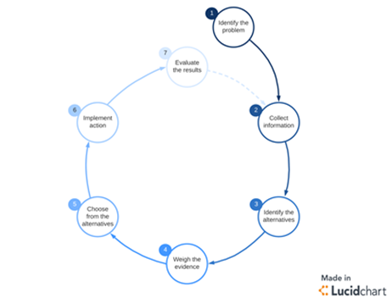
VOCABULARY
7 Steps of the Decision-Making Process
1 Identify the problem
2 Collect information
3 Identify the alternatives
4 Weigh the evidences
5 Choose from the alternative
6 Implement action
7 Evaluate the results

Slide 9
PRACTICE
Complete the sentences with the correct word using the previous vocabulary
The steps for a problem solving are………………
When you determine the factor of something you……..
When you have a final choice about something that means you have to ……….
After you analyze something you have to ……………….
When you verify something you ………….
The 7 steps of decision making process are ………
After you identify the problem you have to ………
Before you evaluate the results you have to……..
After you identify the alternatives you have to………..

Slide 10

Reading Strategy Making Predictions
Video https://youtu.be/nsLD33rczFA

Slide 11
Difference between Analyzing and Evaluating
Difference between Analyzing and Evaluating
Analyzing and evaluating are needed in everyday life especially in cognitive tasks such as comprehension and making smart decisions. Both are also involved in data science as they deal with critiquing evidence. Moreover, they work hand in hand as analyzing is needed in coming up with an efficient evaluation. In consequence, these complementing processes are evident in how we understand and appreciate information.
“Analyze” and “evaluate” are two key terms in knowledge objectives as these are needed in actualizing higher order thinking skills. For instance, students are required to analyze theories, issues, experiences, and other related concepts. Also, learners are tasked to make a stand and explain on their judgments. Indeed, analyses and evaluations are key processes in learning and are essential in the advancement of disciplines.

Slide 12
Difference between Analyzing and Evaluating
Difference between Analyzing and Evaluating
Process in Analyzing and Evaluating
The main difference is that analyzing involves breaking a concept into its parts for better interpretation while evaluating requires determination of significance.
Inference of Analyzing and Evaluating
The inference from analyses concerns interpretations as to implications, meanings, and justifications. On the other hand, the inference from evaluations look into the estimation of quality.
Sequence in Analyzing and Evaluating
Generally, analyzing comes first before evaluating. In order for you to find out the value you have to identify the elements. For example a real estate agent can only identify the price of a property if he already knows its location, measurement, scarcity, and other features.

Slide 13
Difference between Analyzing and Evaluating
Compulsory Results in Analyzing and Evaluating
Normally the result of an evaluation should be the resulting quality. On the contrary, a result is not that compulsory in analysis as it only mainly involves interpretation.
Length of Mental Process in Analyzing and Evaluating
Analyzing usually includes a longer thinking process as it deals with segmentation and classification while evaluating basically deals with the conclusion.

Slide 14

WRAP-UP
Answer these True/False questions about the text.
Analyzing and evaluating are needed in everyday life
“Analyze” and “evaluate” are not crucial key terms in knowledge objectives
Analyses and evaluations are key processes
The main difference is that analyzing involves breaking a concept
Analyzing comes after evaluating

Slide 15
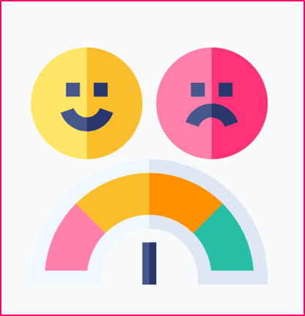
SELF-EVALUATION
Answer these questions
La predicción de un texto me ayuda a interpretarlo mejor.
Si No Talvez
Comprendo que las predicciones son basadas en las evidencias que me suministra el texto
Si No Talvez
Comprendo que en ocasiones las predicciones pueden ser incorrectas por lo que debo siempre rectificar.
Si No Talvez

